Slide 1
L eadership And Total Quality Management.
(5S/Kaizen/TQM)
Dr. Md. Emdadul Haque
National Consultant (HEU),
MOH&FW
Notes:
5s KAIZEN-TQM

Slide 2
Why does Quality matter?
Increases the health status of individuals and the population
Poor quality can do harm
Social and economic benefits
Increases the efficiency of the health system

Slide 3
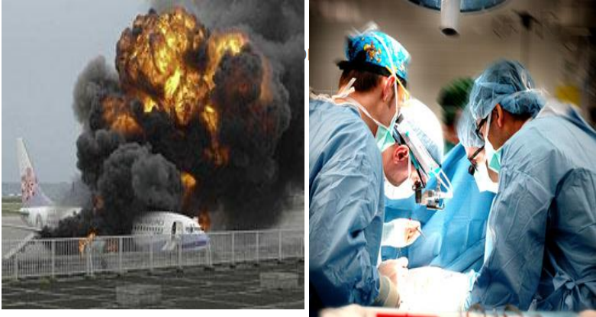

Slide 4

Oh dear!

Slide 5

Who should care!

Slide 6
Inaccurate test results
Test result is lost
Long waiting for consultation
Doctor cannot be contacted for emergencies
Hospital acquired infection
Wrong administration of drug/infusion
Failing supply system
disorganized hospital….
6

Slide 7
Many Hospitals do not look at patients as human being
Dignity
Basic human needs
Prompt attention in care and treatment
Confidentiality
Communication
Health service is not focused on customers’ expectations, and
Service is not attractively presented to people
Medical technology saves lives, Management is also helpful in saving lives

Slide 8
Back yard service function
Kitchen, Linen, Warehouse, Water supply, Electricity, Pharmaceutical storage, Clinical record storage, etc……
Central services and logistics
Laboratories, Imaging Diag. services, Blood bank, Health INFO, ICU, Op Theatre system, Pharmacy, Hosp. Adm. Section etc….
Front-line Services: Diagnosis, Treatments, Follow-up, Individual health promotion
OPD, Wards, Emergency, Rehabilitation, Social Work, Health education service etc…………………………………..
8

Slide 9
Weakness in the backyard and central services causes weakness in the frontline services
This results in low staff satisfaction as well as low client satisfaction
One of the ways to improve staff satisfaction is to improve the work environment, through application of 5S

Slide 10
5S: Definitions
Sort:
Identify and remove unnecessary and unused items from the workplace & reduce clutter
Set:
Arrange necessary items in order to reduce time for searching and retrieving and for easy operation
Shine:
Keep the workplace clean so that there is no dust on floor, machines or equipment (maintain daily cleaning schedule)
Standardize:
Set up the above 3Ss as norms in all the places
Sustain:
Training people to follow good work habits and strict observation of workplace rules

Slide 11
Sort
Unwanted item store
Use of red tag to identify the unwanted items, all the items should be labeled with explanation of problems
From indoor to outdoor, no area should be spared
Segregation of solid waste and introduction of the concept of reducing and reusing of waste
Organize big sorting day once in a month

Slide 12
Sort
<Classification of items and actions against them>
Always Necessary
Keep in the venue and make as an object of “Set”
Keep in the storage and make it available to use when necessary
Occasionally Used
Unnecessary
Keep in the store and discard after permission has been granted

Slide 13
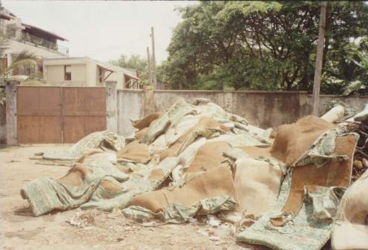
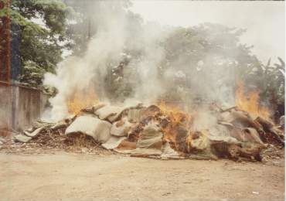
Sort
Discarding unnecessary items

Slide 14
Set
Target and prioritize places for easy application
Use 5S tools to set the work stations, such as color coding, X-axis Y-axis principles, etc.
Label the rooms based on their functions
Place name tag and board (e.g., direction board)
Set the inventory system with tagging and labeling the equipment and other items, including fixation of their location

Slide 15
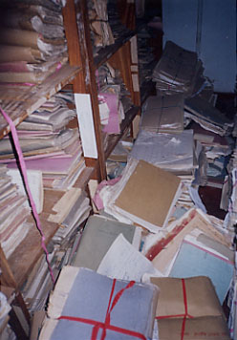
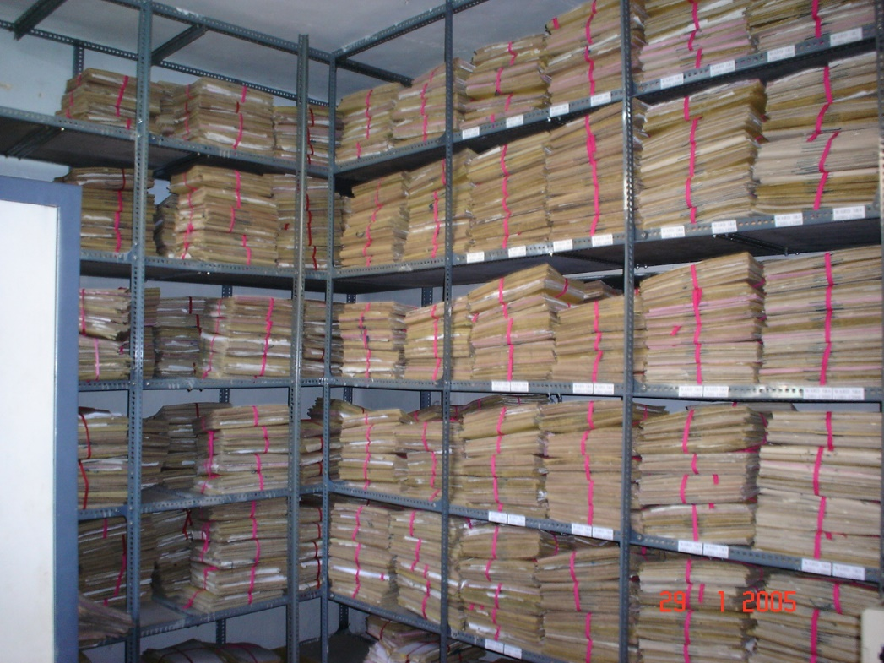
Set
Before
Documents orderly kept for work
efficiency
After

Slide 16
SUPER5S
1
2
3
4
5
6
7
8
9
10
11
12
Retrieval within 30 seconds
Labeling reserved seats
Color identification
1
2
3
4
5
6
7
8
9
10
11
12
1
2
3
4
5
6
7
8
9
10
11
12

Slide 17
Shine
All staff should participate
Periodical implementation of shining activity – e.g., 10 minutes daily, 20 minutes weekly and 30 minutes monthly etc.
Improve cleaning staff’s work environment
Equipment maintenance (regular cleaning and covering them when not used)

Slide 18
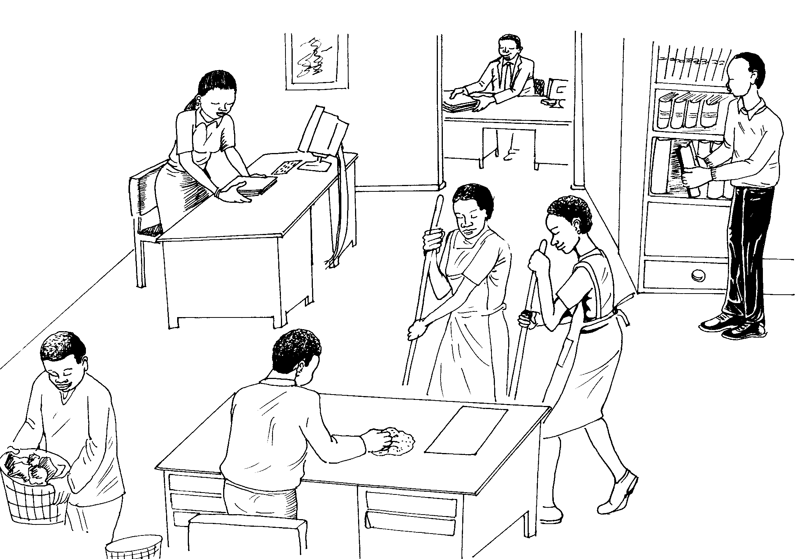
Shine
All personnel in the hospital participate in the activities regardless of category, rank or gender

Slide 19
Standardize
Make 3S activities as a part of routine work for the staff
Visualize the slogans
Standardize the color coding system
Monitoring and evaluation

Slide 20
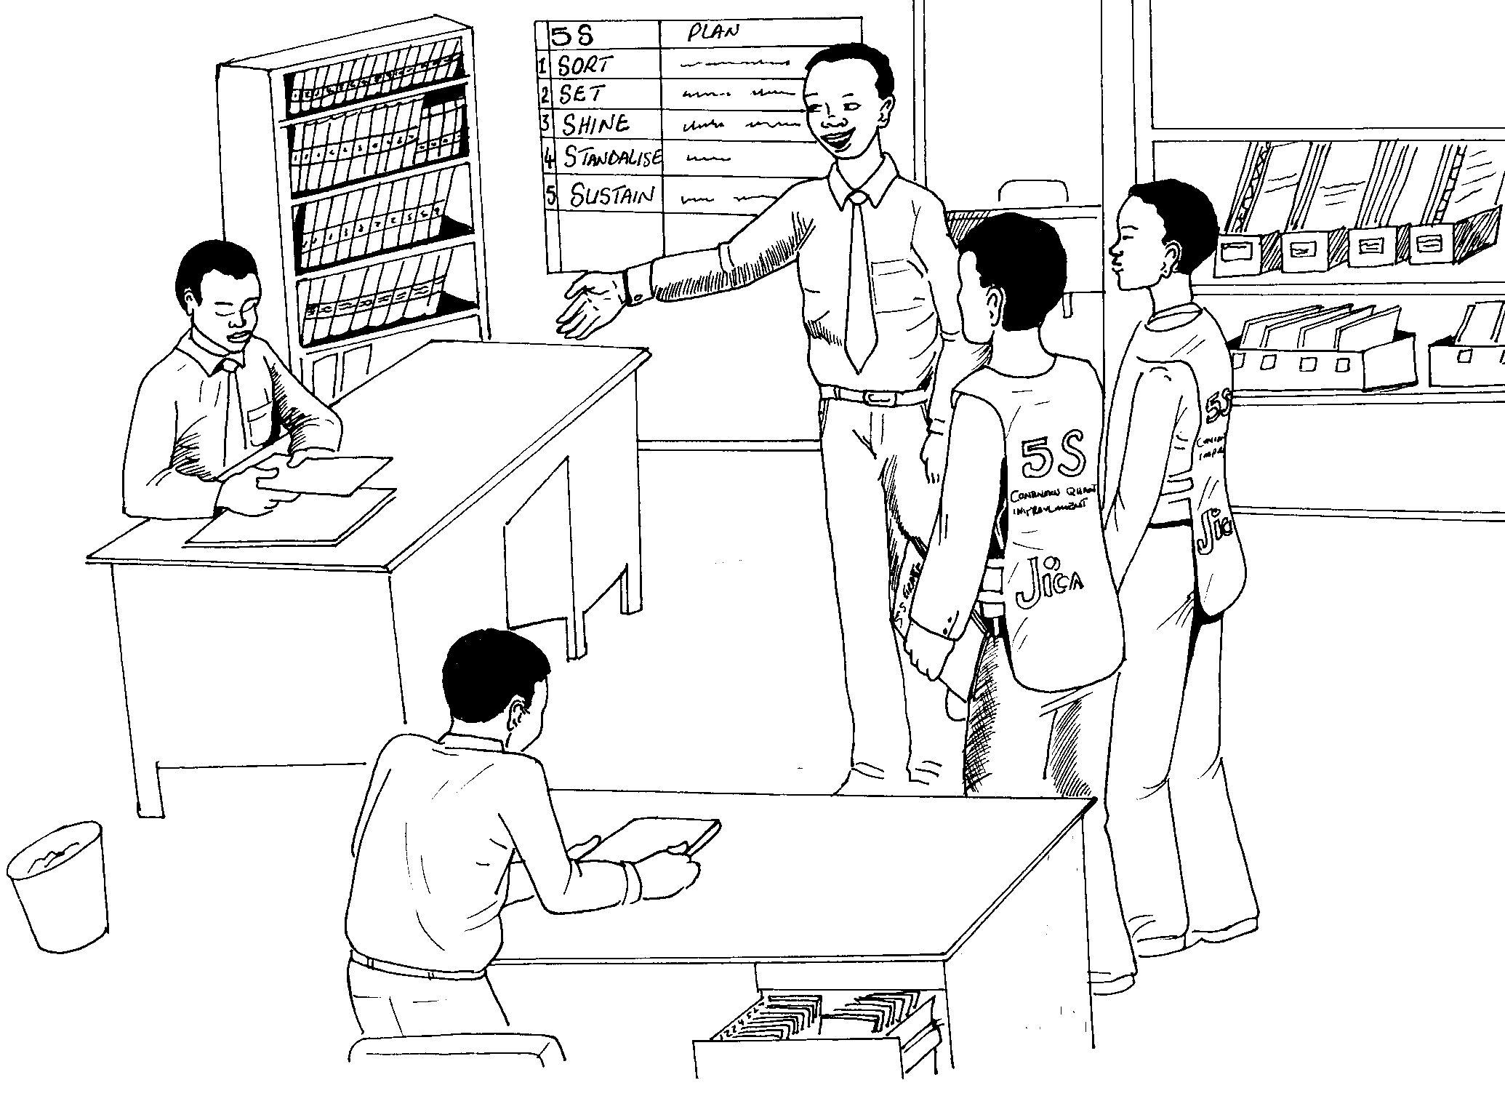
Standardize
Visualizing Slogans
Monitoring

Slide 21
Sustain
Improvement of self discipline through training to all staff starting from nurses, doctors and other staff
Orientation during the WIT meetings
Stimulation to WITs through positive competition

Slide 22
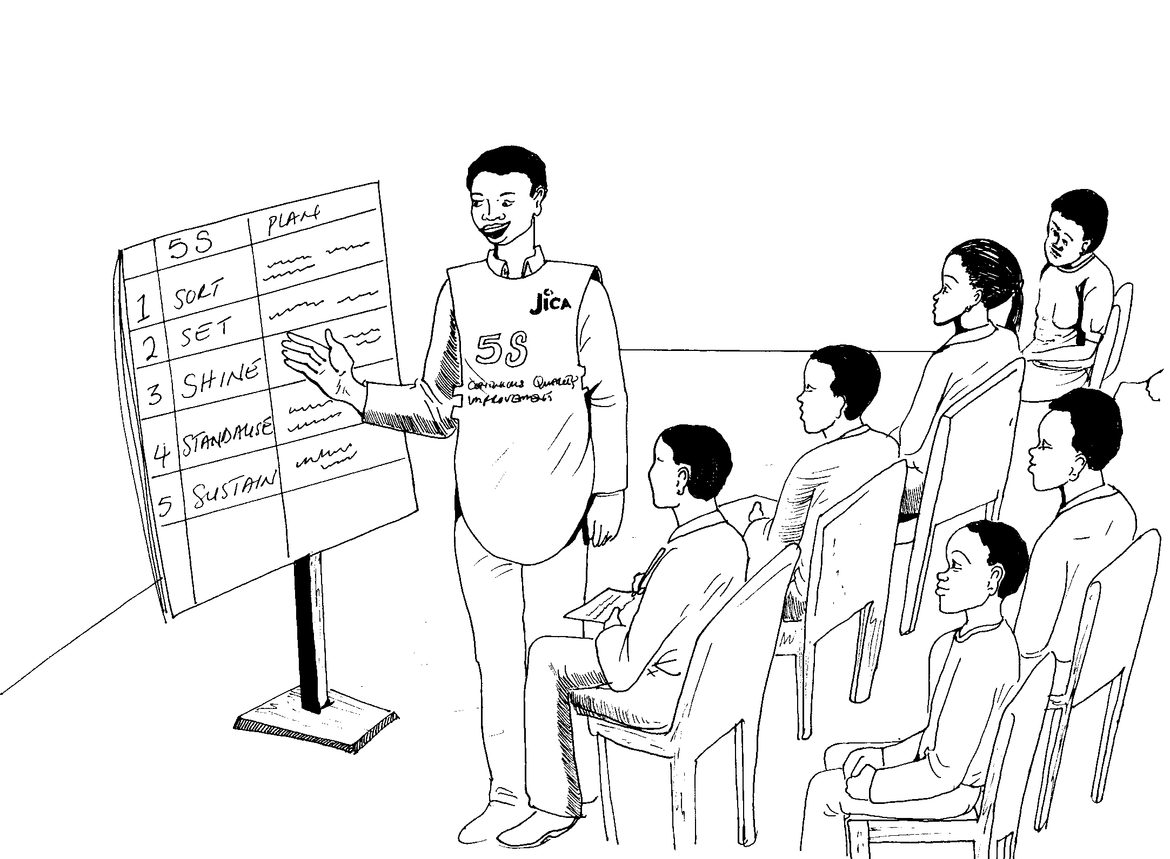
Sustain (Shitsuke)
Introductory training to nursing officers and midwives, then to doctors by top management or QIT team leader

Slide 23
5S Activities: Implementation
Train the hospital staff
Support implementation
of 5S activities
Monitor & assess
achievements of WITs
Coaching the WITs
Taking leadership &
support 5S activities.
Learn and practice 5S
principles by him/herself
Top management
Implement 5S in respective
work units/division
Conduct periodical
monitoring
Reporting to QIT
Quality Improvement
Team
[5 - 15 persons]
Work Improvement
Team
[3 - 5 persons]
Work Improvement
Team
[3 - 5 persons]
Work Improvement
Team
[3 - 5 persons]

Slide 24



KAIZEN(CQI)
A frontline-based problem solving approach
Incremental but continuous progress

Slide 25


INNOVATION
Dramatic but intermittent progress
THE IDEAL
ACTUALITY
Higher standard achieved through innovation is subject to deterioration unless continuing efforts are made first to maintain it and then to improve it

Slide 26
KAIZEN PLUS INNOVATION
Desirable progress by combination of two opposing approaches
MAINTENANCE
INNOVATION
NEW STANDARD
KAIZEN
MAINTENANCE
INNOVATION

Slide 27


Slide 28
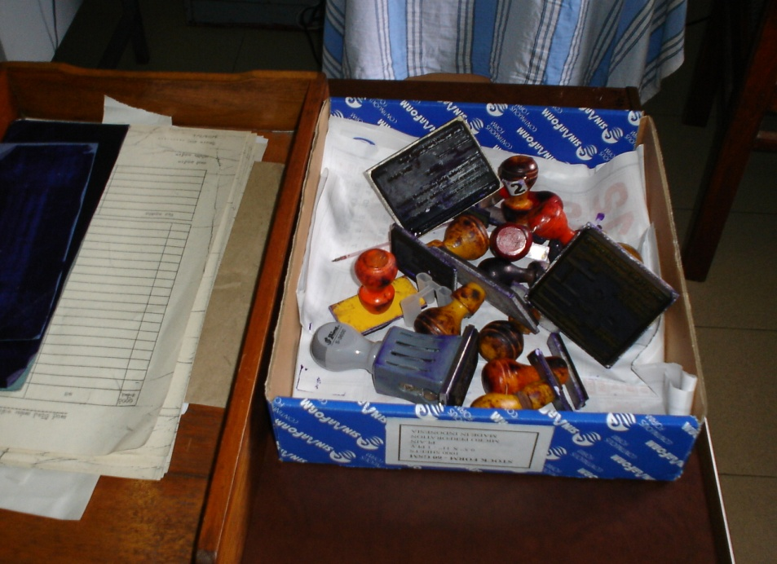
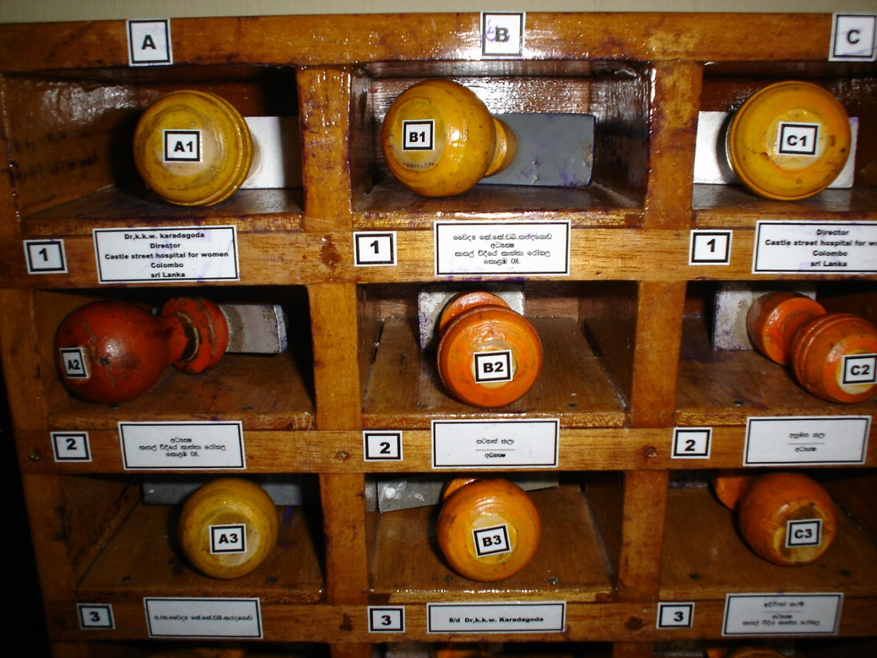

Slide 29
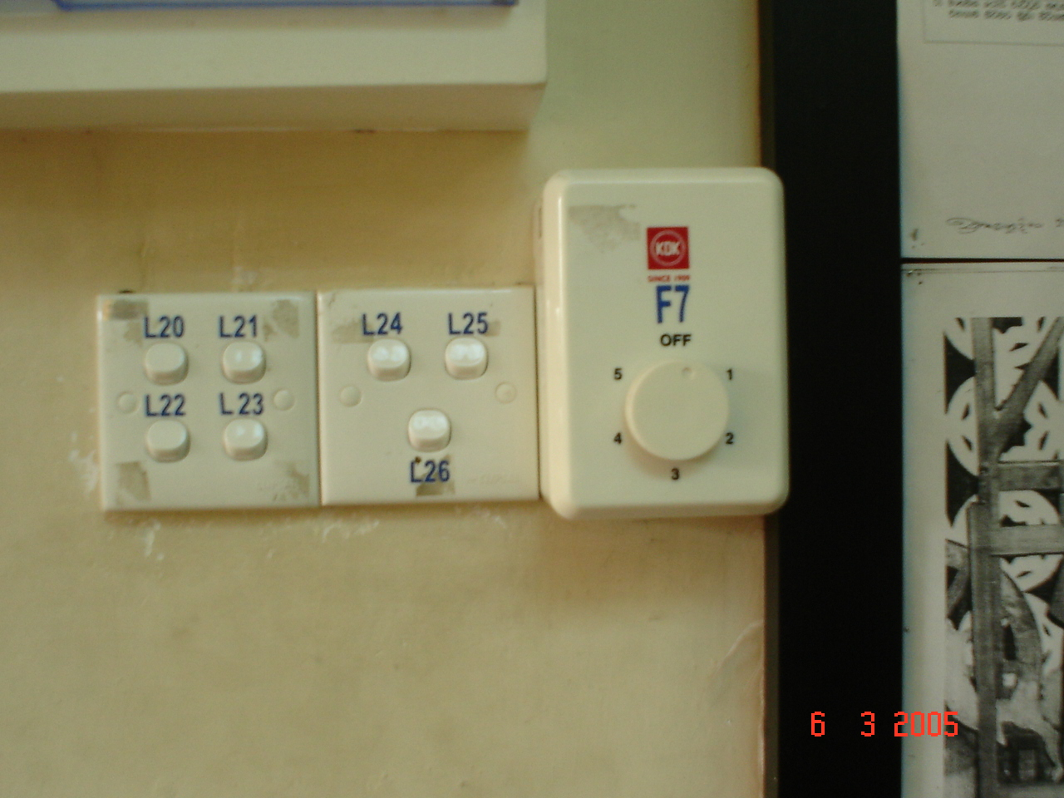

Slide 30
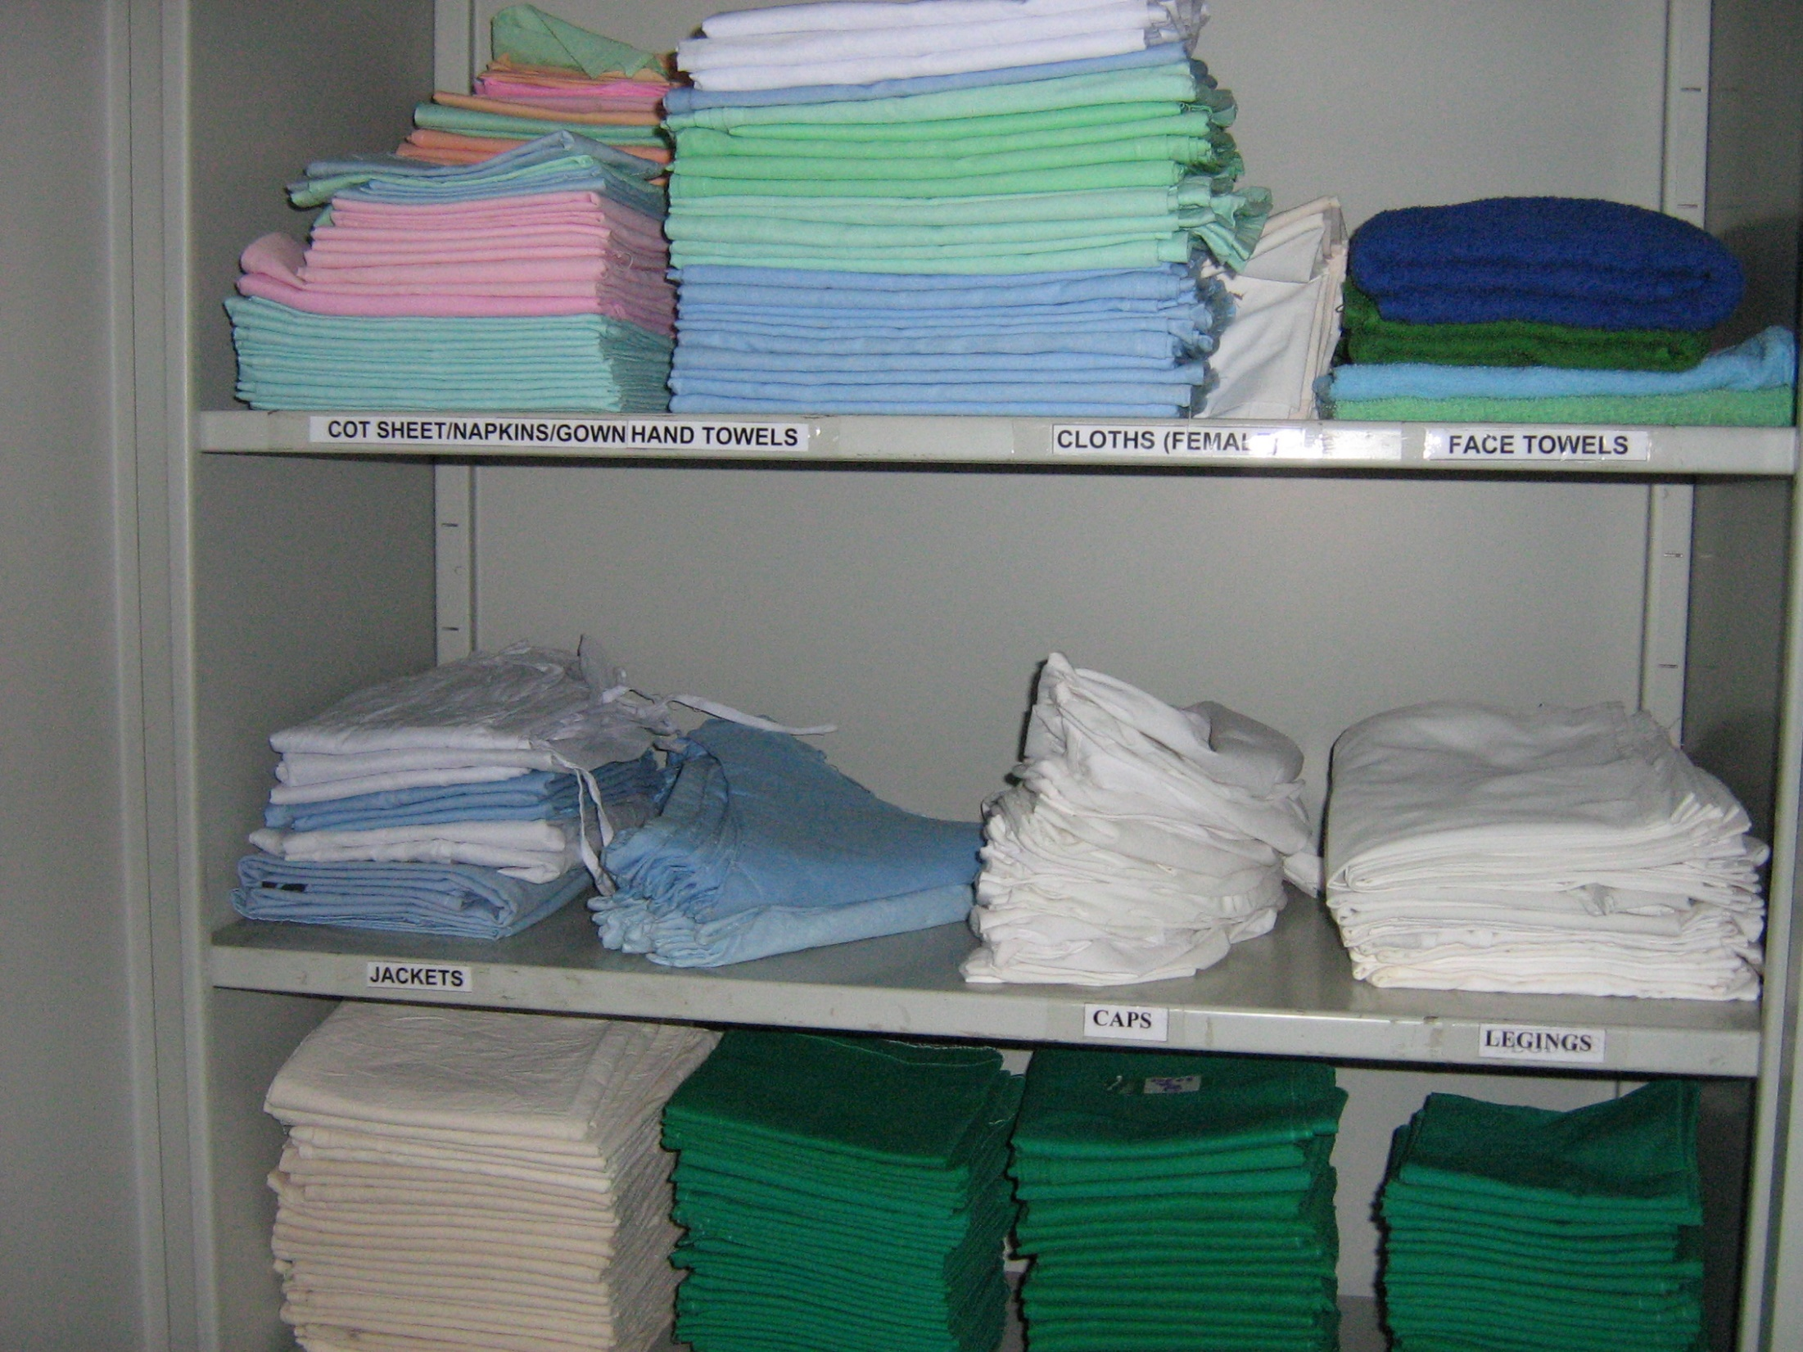

Slide 31
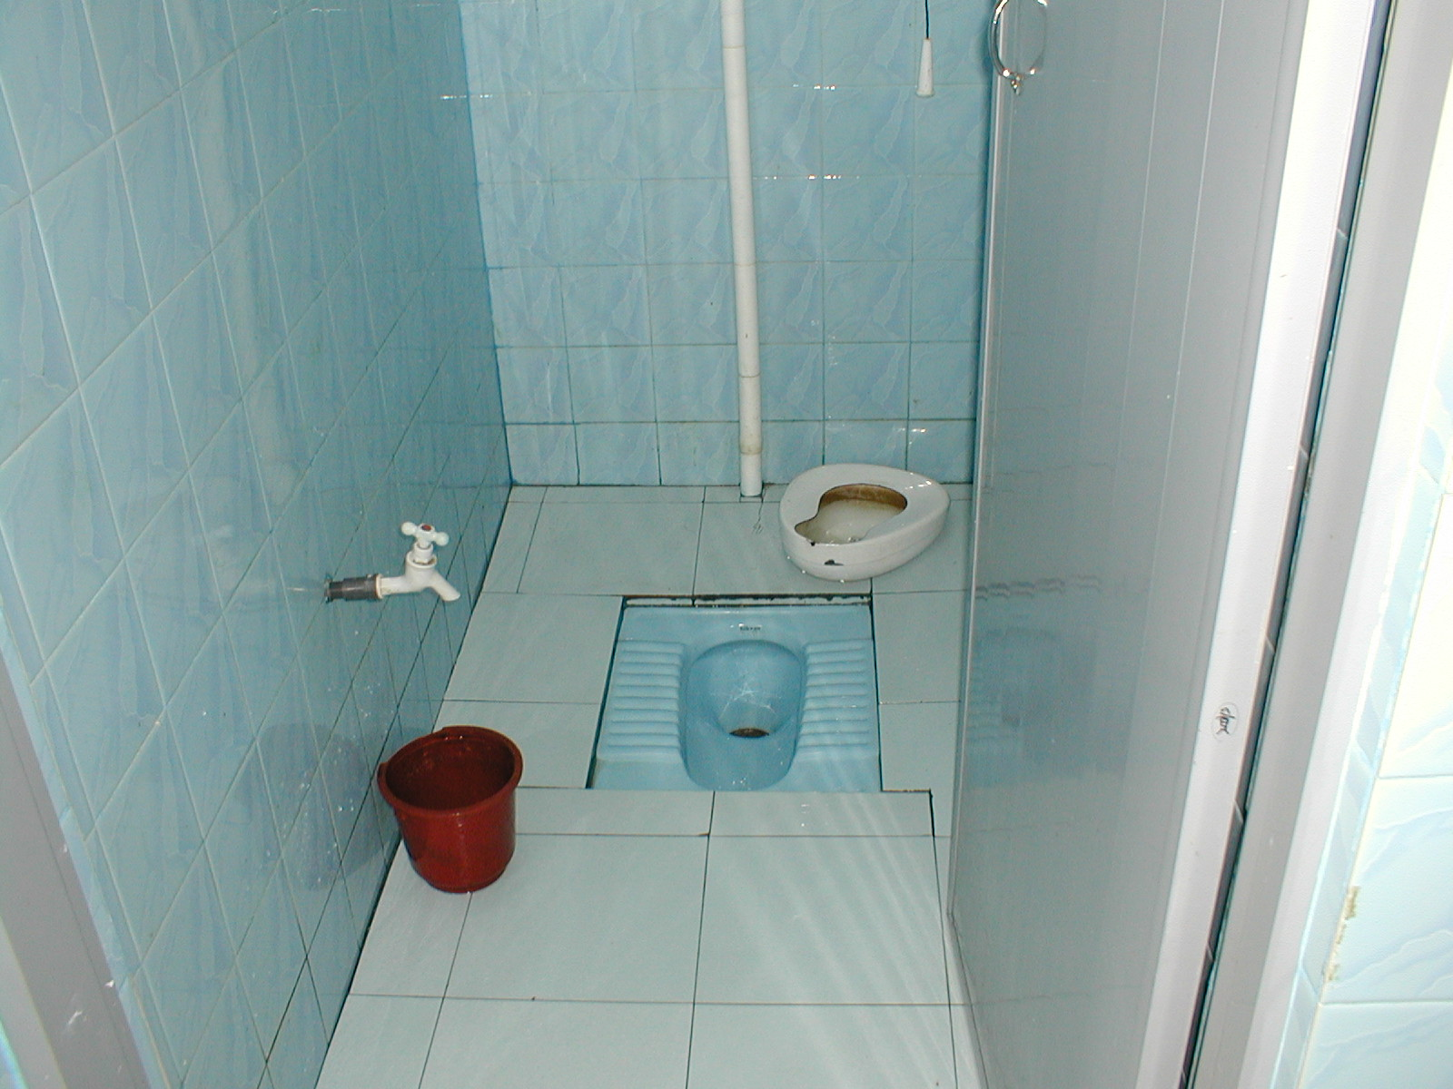
Shine (Seisou)
Keeping the toilet clean is also an important activity for Shine.

Slide 32
Bangladesh Experience
QIS has been supporting the DGHS to implement 5S/Kaizen/TQM in 12 district hospitals
Staff received orientation on 5S at all hospitals
WITs and QITs have been formed with development of action plan for implementation
The focus is on application of 5S
There are some changes in some of the areas, but much more needs to be done

Slide 33
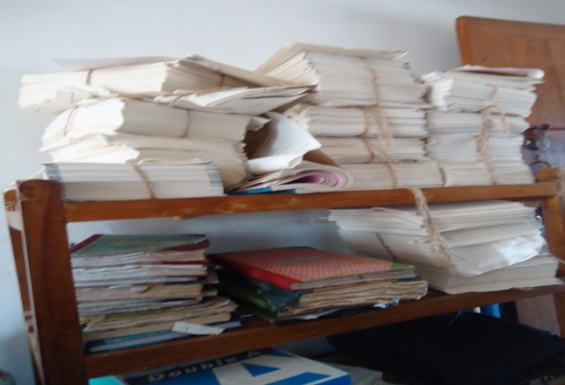
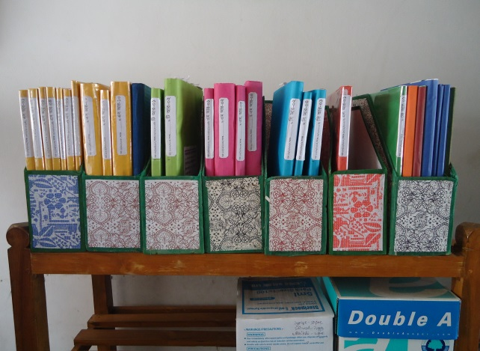

Slide 34




Changes in EOC Ward
Before
After
Before
After
Before
After

Slide 35




Changes in Padietric & Medicine Ward
Before
After
Before
After

Slide 36



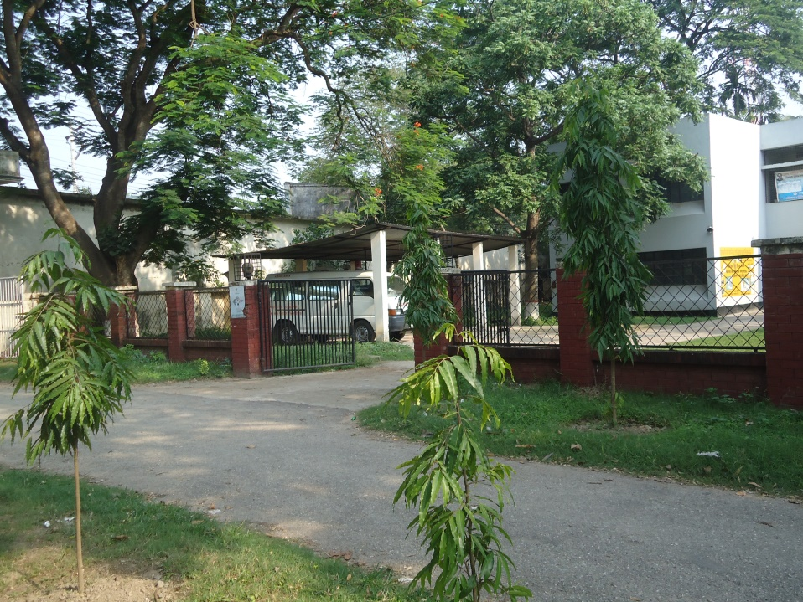

Changes in Gardens of The Hospital
Before
After
Before
After

Slide 37




West Management & Campus Protection
Before
After
Before
After

Slide 38




Improved pediatric word by local initiative

Slide 39

Our usual solution:
We need more RESOURCES!!!!

Slide 40


Slide 41


